Slide 1
Final Project --- Premier League Database
Northeastern University
Jin Lin

Slide 2
Problem Statements --- The Premier League Database
English Profession League for men’s association football clubs
Clubs compete against each other twice, home and away
A match involves many match events
A registration period providing teams to transfer players

Slide 3

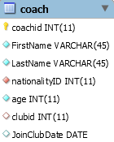
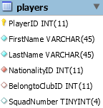
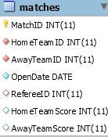
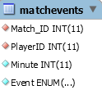
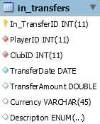
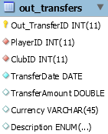
Approach

Slide 4
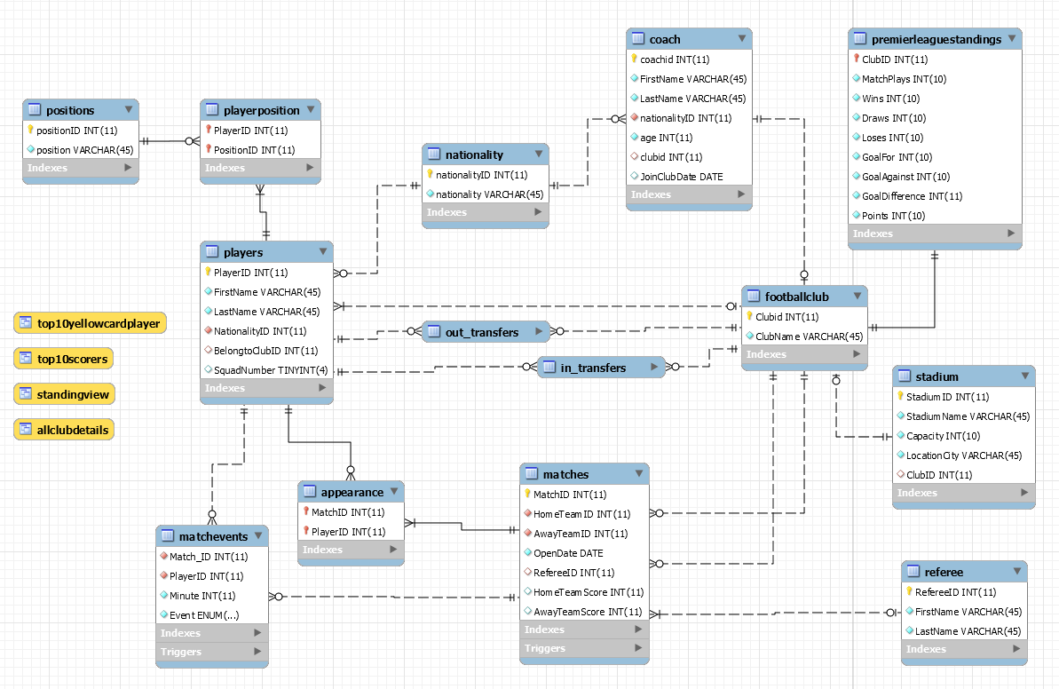
ER Diagram

Slide 5
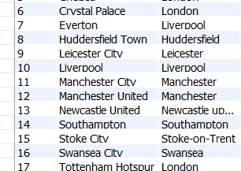
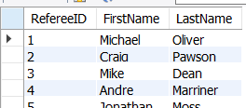
Use case - New Match Happens
View: AllClubDetail
Table: Referee
Manchester United VS. Manchester City played off on Dec. 11, 2017.
Referee: Michael Oliver

Slide 6
Use case - New Match Happens
CREATE `NewMatch`(in Hometeam_id int, in Awayteam_id int, in Open_date date,
in referee_id int, out match_id int)
BEGIN
insert into matches(hometeamid, awayteamid, opendate, refereeid)
value(Hometeam_id, Awayteam_id, Open_date, referee_id);
END

Slide 7
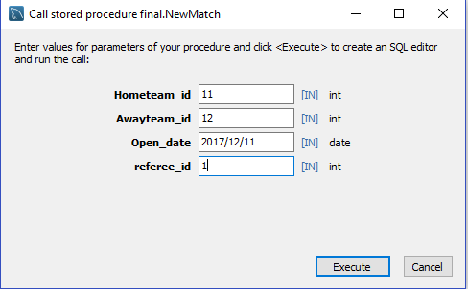
Use case - New Match Happens
Trigger on Table matches after INSERT
CREATE DEFINER=`root`@`localhost` trigger StandingRenew_aftermatchinsert
AFTER INSERT ON matches
FOR EACH ROWBEGIN
set @home = NEW.HometeamID;
set @away = NEW.AwayteamID;
update final.premierleaguestandings
set MatchPlays = MatchPlays + 1,
Draws = Draws + 1,
Points = Points + 1
where (@home = premierleaguestandings.ClubID) or (@away = premierleaguestandings.ClubID);
END
Before
After

Slide 8
Use case – Goal Happens
Table
“matchevents”
Table
“matches”
View
“standings”
Goal
Trigger
Trigger
Insert
Update
Update

Slide 9
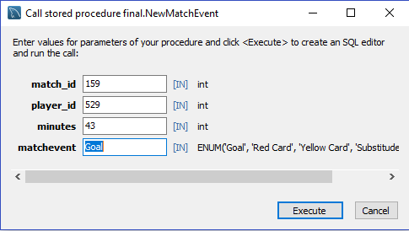
Use case – Goal Happens
SP_ClubMatchRecord
View_Standings
David Silva goals for Man City at 43’
New SP_ClubMatchRecord
New View_Standings

Slide 10
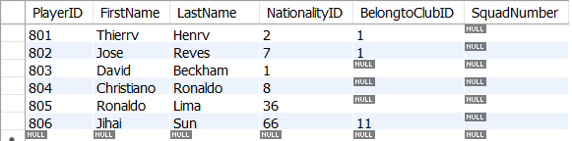
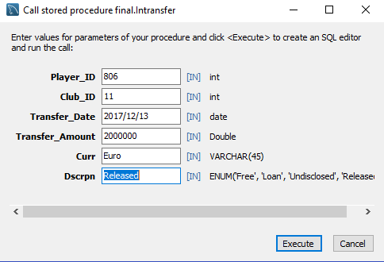
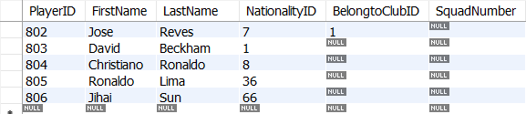
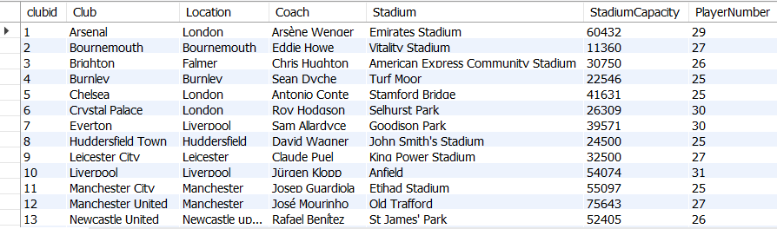
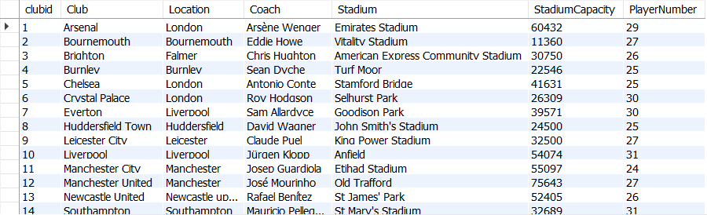
Use Case – In Transfer

Slide 11
Use Case – In Transfer
CREATE `Intransfer`(in Player_ID int, in Club_ID int, in Transfer_Date date,
in Transfer_Amount Double,in Curr VARCHAR(45),
in Dscrpn ENUM('Free', 'Loan', 'Undisclosed', 'Released’))
proc_label: BEGIN
select @club:=players.belongtoclubid from players
where players.playerid = Player_ID;
IF @club IS not NULL THEN
leave proc_label;
END IF;
insert into in_transfers(PlayerID, ClubID, TransferDate, TransferAmount,
Currency, Description)
value(Player_ID,Club_ID,Transfer_Date,Transfer_Amount,Curr,Dscrpn);
END

Slide 12
Database Features
Database Design
14 Tables, 4 Views, 7 SPs, 5 triggers
Data Collection
20 Premier League Football Clubs, 22 Stadiums
18 Referees, 24 Coaches, 540 Players
159 Matches, 684 Match Events
More than 1000 Player Appearance Records

Slide 13
The End
Thank you!
Database Management and Database Design
Jin Lin
Northeastern University

